Slide 1

Local government open data, Virginia beach
Alla Topp
MSDS 640

Slide 2

Local Government Open Data
“Because even in times of recession and debt the one thing governments always have in abundance is data. And it belongs to the people”.
The dataset includes open data of Virginia Beach, VA as a local government;
Local government will have open data available for its citizens for transparency;

Slide 3
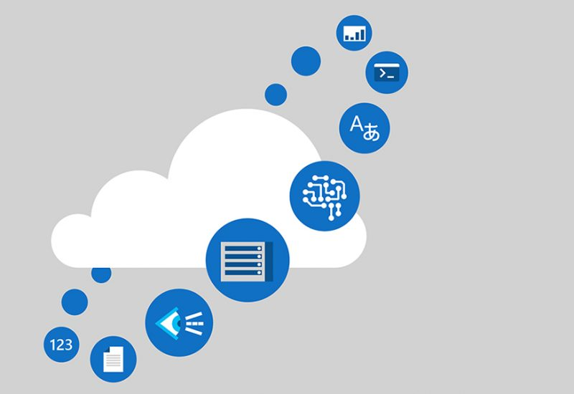
Local government open data expectations
Local government open data can help to save money and provide services more efficiently;
Open data does not mean available data, it is available in the formats people need;
The open data project is still in the early developmental stage, it is very promising;
free publishing government data in a machine-readable format, under an open license, can have salutary economic outcomes ranging from real estate, health, transit, energy, consumer finance, and weather.

Slide 4
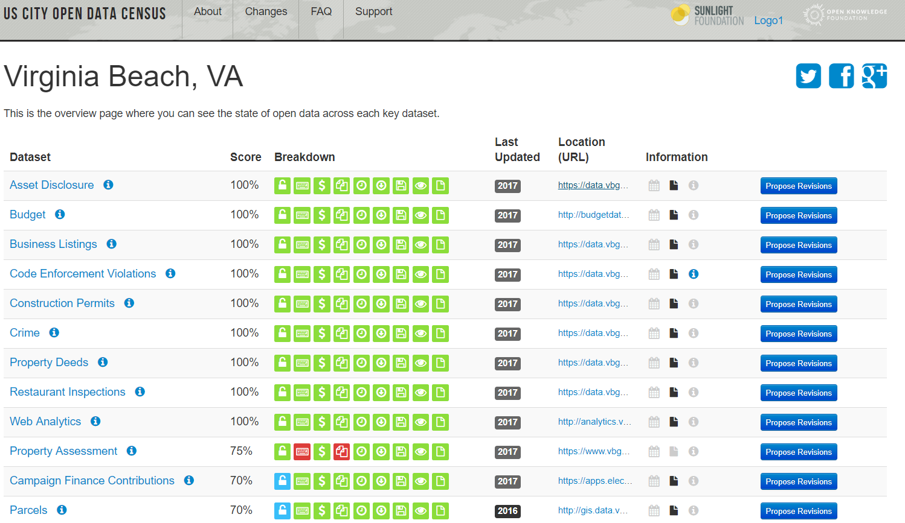
Notes:
On this slide we can see all the open data of Virginia Beach with the links to these datasets and the score.
http://us-city.census.okfn.org/place/vabeach

Slide 5


Social justice issues identified
“Information wants to be free.”
When data is used to allocate resources or anticipate needs, it can perpetuate injustices by overrepresenting privileged groups of people;
governments and corporations gain more power and information from open data, but most people do not;
data can be collected, processed, interpreted, stored, retrieved, and communicated by people who are biased.

Slide 6
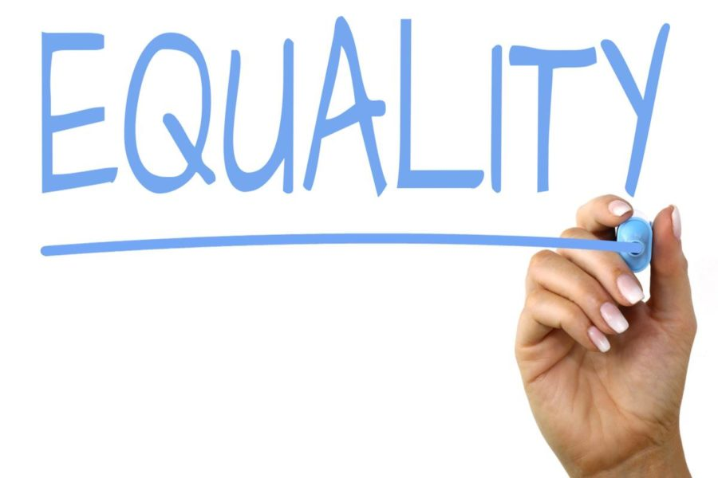
Example of the social injustice in open data
“Consider the Street Bump app that the city of Boston uses to help record rough patches and potholes in the city’s infrastructure. All you have to do is download the app, keep it on while you drive, and, thanks to your smartphone’s GPS and accelerometer, the app will report back the location of any bad parts in the road. The dataset this app creates can be useful and make road work more efficient and targeted, but it also only represents data collected by those who own smartphones”.

Slide 7

Privacy issues
Open data can contain someone`s personal information, or information that should not be disclosed;
Open data can include information from social media from people`s profiles;
Data is used for purposes unrelated to the dataset’s objective.

Slide 8

Example of the Privacy issues
The real estate service Zillow can pilfer open data to determine whether a homeowner has defaulted on the mortgage, if the house has been seized, and how much it might go for in foreclosure.

Slide 9

Ethical issues
Open data can be misused;
Ethical issues of open data is the main ethical issue of open data so far;
Open data can contain discriminatory data;
Open data could be harmful because of misuse of the data and if it is accessed by people with bad intentions.

Slide 10
Summary
“To put it simply, beyond rationales of increased efficiency, reduced costs, increased productivity, and economic growth that will spur the release of new data, there's considerable potential for open data releases to extend to positive social justice, environmental, educational, public safety and health outcomes”. Looking through Virginia Beach open data shows that they have a lot of data available to the public which solves some transparency issues and ethics issues.

Slide 11
References:
Darrow, B. (2014, January 02). The city of Palo Alto's CIO explains the benefits of open data. Retrieved from https://gigaom.com/2014/01/02/the-city-palo-altos-cio-explains-the-benefits-of-open-data/
Harris, D. (2014, January 04). 5 reasons why good governments should embrace open data. Retrieved from https://gigaom.com/2014/01/04/5-reasons-why-good-governments-should-embrace-open-data/
Howard, A. (n.d.). More than economics: The social impact of open data. Retrieved from https://www.techrepublic.com/article/more-than-economics-the-social-impact-of-open-data/
Knowledge, O. (n.d.). Overview - US City Open Data Census. Retrieved from http://us-city.census.okfn.org/
Sadowski, J., & Sadowski, J. (2013, June 28). The Injustices of Open Data. Retrieved from https://slate.com/technology/2013/06/open-data-can-promote-social-injustice.html

Slide 12

Thank you!

